Slide 1

King County Real Estate
Team Alpha Tennent Stakeholder members:
FLORENCE NGUUNI
JOSHUA RWANDA
LEAH KALUMBA
EDNA WANJIKU
STEPHANIE MBITHE
KINOTI MWENDA
07/20/20XX

Slide 2




Overview
Overview : The purpose of this model is to predict price of houses in King county using meaningful interpretations from the data
PRICE PREDICTION ACCURACY
IMPORTANT REAL ESTATE FEATURES
LOCATION
PRICE AND OTHER FEATURES

Slide 3
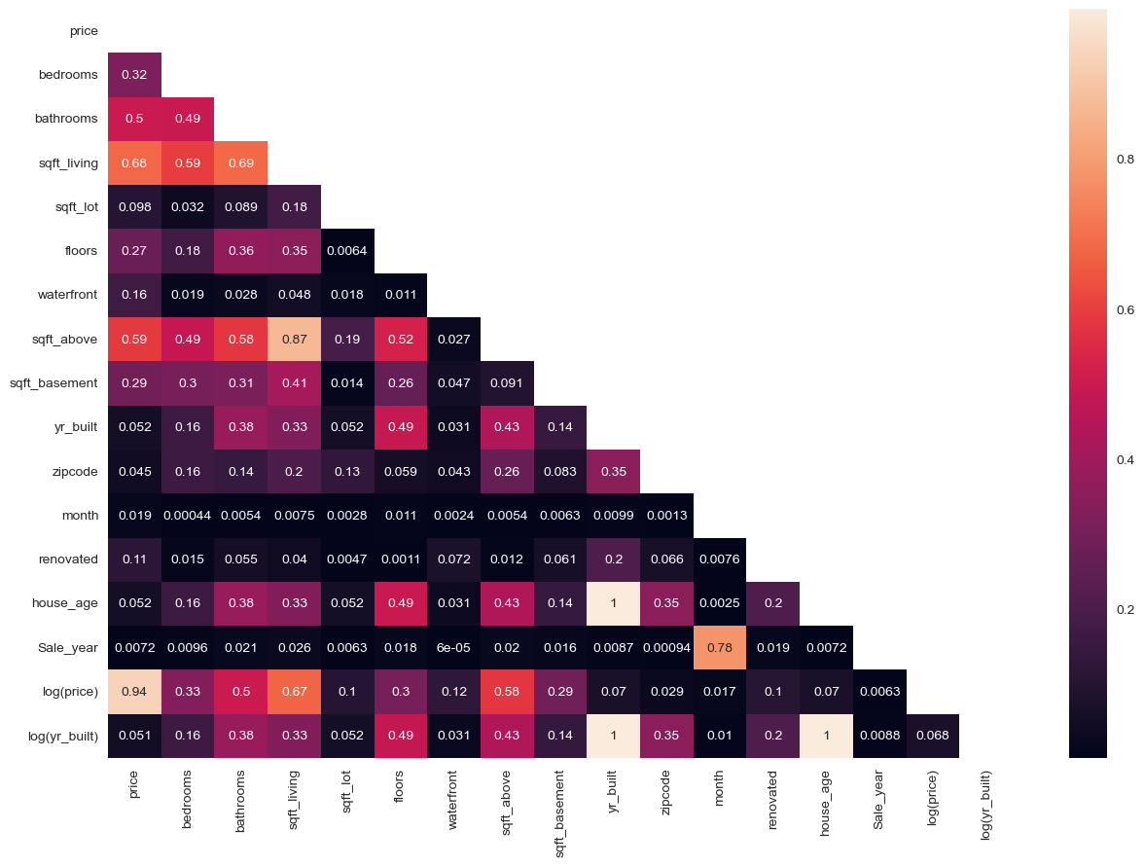
Features
price - view
bedrooms - condtion
bathrooms - grade
sqft_living - sqft_basement',
floors - yr_built
waterfront - month
Zipcode - Sale_year
Renovated - log price
house_age - log(yr_built)

Slide 4
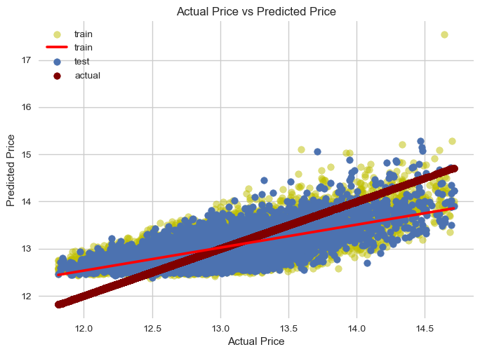
Actual Vs Predicted Price
The Mean absolute Error(mae) of the Train is 28.9% while the Mean absolute Error(mae) for test is 28.8%
*The mean_squared_errorr(mse) of the Train is 12.5% while the mean_squared_error(mse) for test is 12.3%
*The root Mean squared Error(rmse) of the Train is 35.4% while the root Mean squared Error(rmse) for test is 35.1%
*r2_score is 51.1% that is to say our model explains a 51.1% variance in Price​

Slide 5
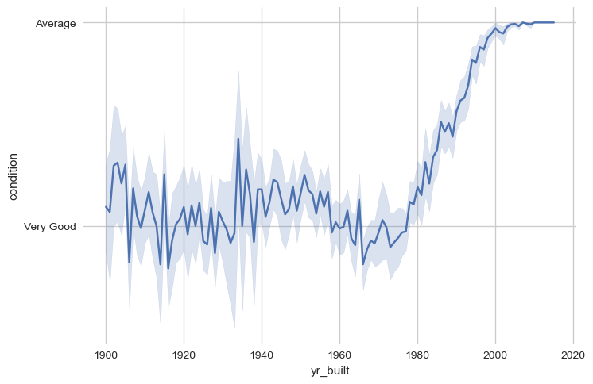
BIVARIATE ANALYSIS
For most houses built in the $20th$ century *i.e.* 1900-early 1990s houses were in Very good condition.
* For most houses built from the beginning of the $21st$ century, the condition is Average. There seems to be a decline in condition of houses built over time

Slide 6
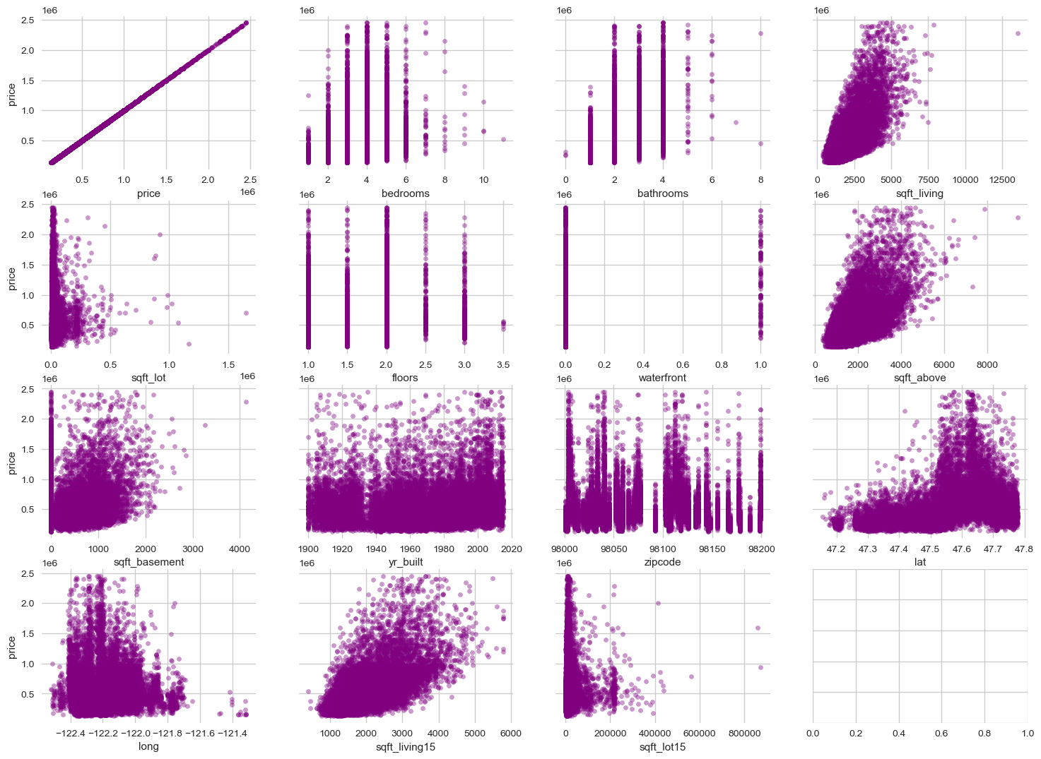
How ``price`` and the other variables relate and created in the ``numerical_list`` created above.
From the plots above, we can observe that some of the relationships within the variable are linear while other are non-linear.

Slide 7
Conclusion
Virtual communication will be more common in the next 5 years. ​
​

Slide 8
Recommendation

Slide 9
Recommendation
9%
10%
Text messages
Social media
23%
58%
Message boards
Virtual reality

Slide 10

Proposed Solution
Take risks to lead in product innovation​
Listen to customers and learn what they need​
Test with customers until you get the product right​

Slide 11


Comparing Contoso to the competition​
Contoso empowers businesses to communicate efficiently with technology that’s simple and easy to use.​
​
The competition also offers similar technology, but their tools aren't user friendly.​

Slide 12
History
Launch Contoso​
Request
funding​
Procure investments​
20xx
Jan
Feb
Mar
Apr
May
Jun
Jul
Aug
Sep
Oct
Nov
Dec
Hire designers​
Open offices​
Start development​
20xx
Jan
Feb
Mar
Apr
May
Jun
Jul
Aug
Sep
Oct
Nov
Dec

Slide 13

Key takeaways​
Virtual communication is the future​
Contoso is leading in virtual communication​
Contoso helps businesses communicate effectively ​
Contoso is free to try and easy to use​

Slide 14

Tips for businesses​
Take risks to lead in product innovation​
Listen to customers and learn what they need​
Test with customers until you get the product right​

Slide 15

Call to action
Contoso is the best technology platform on the market​
Download Contoso to try it out and provide feedback​
​

Slide 16


Thank you
Mirjam Nilsson​​
206-555-0146​
mirjam@contoso.com​
www.contoso.com​

